Slide 1
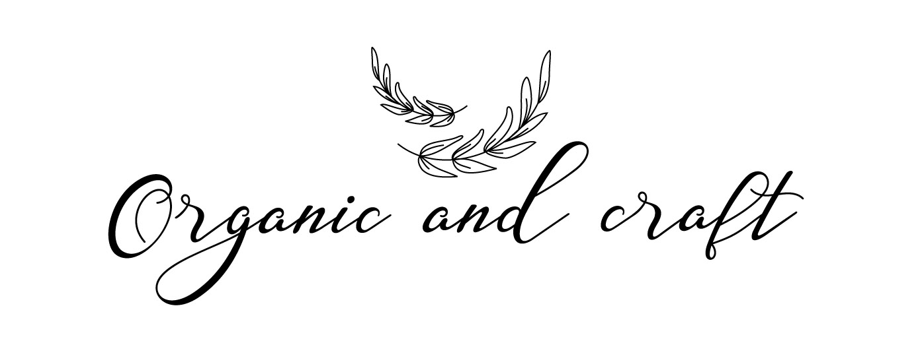

Supply
Chain
Management
India
has the vision, eco-system
& resource
capabilities
to provide
the qualitative
low cost
product
manufacturing
for all kinds
Of Industries
in the Globe!

Slide 2
PRODUCTS
BABY – INFANT APPARELS, STORAGE & ACCESSORIES
WOMEN- MATERNITY APPARELS, HI FASHION, YOGA APPARELS ACTIVE WEAR, BEACH WEAR & ACCESSORIES
MEN- FORMAL, ACTIVE WEAR & ACCESSORIES
TOP OF BED – BEDDING, CUSHIONS & THROWS
FLOOR COVERING – CARPETS & RUGS.
BATH – BATMATS, TOWELS & CERAMIC DISHWARE
POUFS & OTTOMANS
KITCHEN LINEN
TABLE LINEN
HOME DECORATIVES
WOODEN FURNITURE
HARD GOODS – GARDEN & DECORATIVES ETC.
UTENSILS & CUTLERY
ESSENCE & CANDLES

Slide 3
SUPPLY CHAIN
&
STRATEGY
01
PRODUCT DESIGN
02
SOURCING & PROCUREMENT
Organic and Craft is India’s professional Sourcing & SCM organization. We assist customers to achieve modest advantage in their businesses by identifying the non core activities in their value chain, crafting & implementing sourcing strategy in orientation to their vision & long term goals.
Located in Noida, we work for variety of customers from startups to the established global brands. Our customers simply rely on us as we deliver the best value & measurable strategic outcomes.
Organic and Craft takes proud to leverage the skills of it’s highly qualified global strategy consultants & industry experts. Our team shares a strong belief in ethical, customer centric, quality & cost effective solutions.
03
QUALITY CONTROL &
INSPECTIONS
04
VENDOR MANAGEMENT
05
ENHANCE SUPPLY CHAIN
06
4PL LOGISTIC SERVICES
07
MARKET RESEARCH
08
COMPLIANCE

Slide 4

ORGANIC AND CRAFT
SUPPLY CHAIN
PRODUCT
DESIGN

Slide 5
01
PRODUCT DESIGN
Game changer for any business is Right Design and Trends, how?
We at Organic and Craft, strongly believe in research. We travel frequently both locally & globally to explore regional markets, fairs, visit to suppliers/customers, proud to engage a team of full time designers, who decrypt the future design trends and offer you the most trendy, unique range of products, so that you stay ahead always!
We are also proud to deliver several best sellers since establishment and the numbers are growing year-on-year. This stunning success is recognized to our capable and hardworking design team. We can be a game changer if you hire us.
Our Motto "Push your brand to go beyond single sale and retain end customers for life".
RIGHT DESIGN ASSORTMENTS
PRIMARY & SECONDARY RESEARCH
ENGAGE FULL TIME DESIGNERS
O&C
Design
Develop
Launch/ Delivery
Ideate
DELIVERED BEST SELLERS
Notes:
5

Slide 6
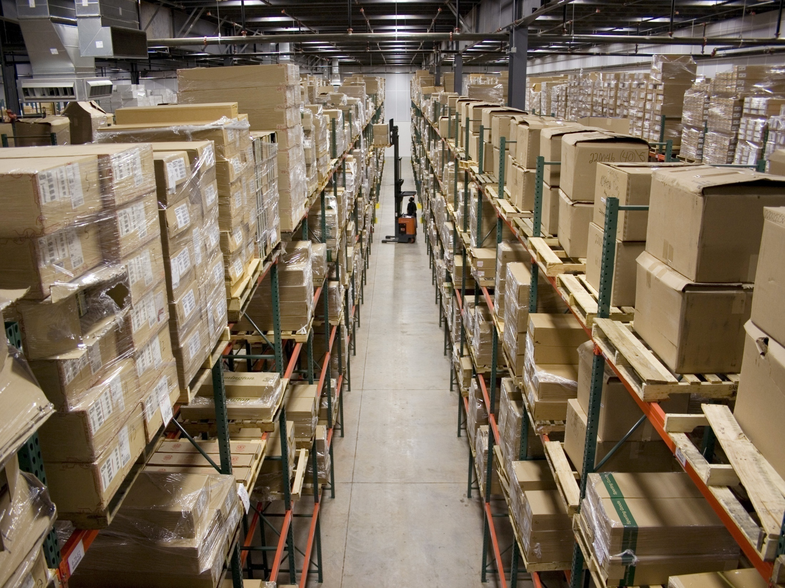
ORGANIC AND CRAFT
SUPPLY CHAIN
SOURCING &
PROCUREMENT

Slide 7
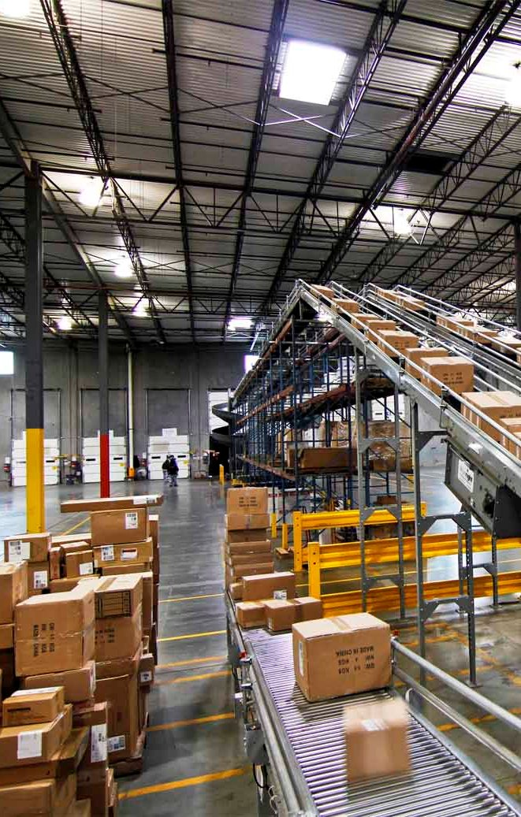
02
SOURCING &
PROCUREMENT
A high operational business team can help you in browsing sales opportunities in your market, how?
This can be possible by building a company’s trustworthy supply base. It plays a key role, takes time & resources to identify, qualify and engage suppliers to build a vigorous supply chain of future.
We, at Organic and Craft, assist your buying team to accumulate and authenticate a list of reliable suppliers through our tight selection process. By enlarge tons of information is available on the internet, which is prodigious, however challenging to trust. Here, we offer you our infinite support and provide market visibility to identify adequate suppliers, who can meet your quality & service level requirements for the goods being purchased.
Screening process includes the following:
- Industrial broadcast & Search Engine.
- Local Itinerary & Social Network.
- Visit to the factory.
-Key Documents Examination i.e. Business registrations integrity, Company profile selection, Compliances.
At the same time, we bridge the overall process by motivating suppliers to take interest, invest good time &
efforts in earning your valuable business. Thus, making a cultural balance !
HIGH FUNCTIONING TEAM
VALIDATE SUPPLIERS
BUILD RELIABLE SUPPLIER BASE
ENDLESS SUPPORT
TIGHT SCREENING PROCESS

Slide 8
ORGANIC AND CRAFT
SUPPLY CHAIN
QUALITY CONTROL & INSPECTIONS
QUALITY
O & C
APPROVED

Slide 9
03
QUALITY CONTROL & INSPECTIONS
Cost, Quality & Time are of supreme importance at Organic and Craft. On field inspections by our skilled & proficient QCs are key to ensure that quality product is rolled out for you from production floors. We implement 4 levels of inspection format: Inline, Midline & Final inspections on the production floor enhanced with a surprise visit, which leaves no scope to error on quality. The process goes like this:
Pre-production meeting – We start it with a sealed sample handed over to factory by Organic and Craft. The idea behind is to discuss possible call outs with production team in the factory, specific instructions to be taken care of during production, it also involves various approvals Organic and Craft gives on behalf of buyer in emergency etc. Overall, it eliminates misperception/myth related to products or production of goods at supplier’s end. Last but foremost, inspection offer dates are discussed.
Inline, Midline & Final - We practice AQL 2.5- 4.0 and ensure following goods shown & inspected by our QC.
15% during Inline,
50% during Mid-line & 100% during Final.
We are proud to achieve claim ratio of less than 0.4%.
In the process, we ensure to meet your testing & CSR requirements by the supplier, which makes your socio-ecological responsibility fulfilled and reinforce your sourcing decision.
ON FIELD INSPECTIONS/ AUDITS
MINIMIZE DEFECTS
4 LEVELS OF
QUALITY CHECK
TESTING & CSR
FULFILLMENT
LESS CLAIM
RATIO
PRODUCT CONSULTING
QUALITY
O & C
APPROVED

Slide 10

ORGANIC AND CRAFT
SUPPLY CHAIN
VENDOR MANAGEMENT

Slide 11

04
VENDOR MANAGEMENT
We take 360 degree view in vendor’s selection. Market information, right attitude, information limpidity, studying company profile are few initial ways to know the reliability of supplier.
Once, we strictly shortlist the reliable & capable suppliers for you, their management is necessary to evaluate their performance later on i.e. spend analysis, delivery charts etc.
Services offered under 4PL are:
Under considered circumstances, we pay them regular visits to forge a good relationship, motivate them to substitute creativity & services required for our business in a longer run.
360° APPROACH
INFORMATION
CENTRALIZED
SUPPLIER
RELATIONSHIP
FOSTER
INNOVATION
BETTER PERFORMANCE

Slide 12
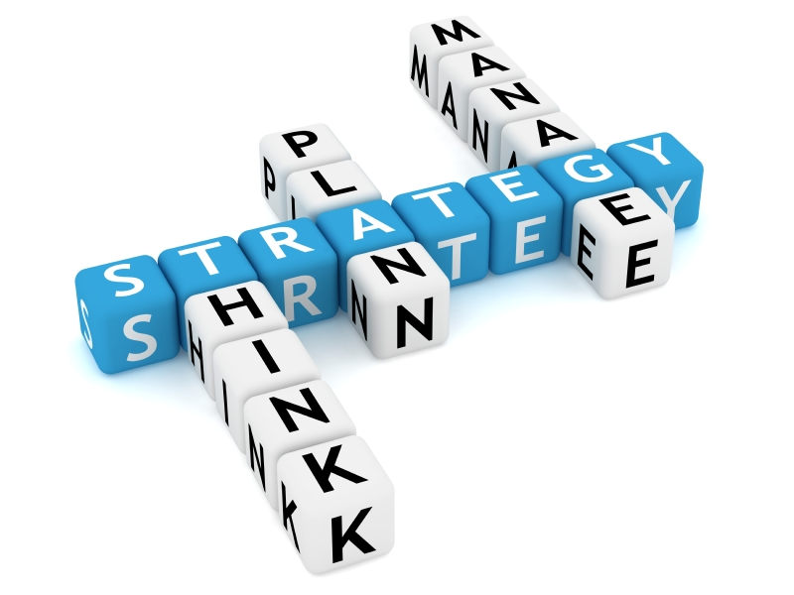
ORGANIC AND CRAFT
SUPPLY CHAIN
ENHANCE
SUPPLY CHAIN

Slide 13

05
ENHANCE SUPPLY CHAIN
Our acquaintance and experience allow us to maximize value and re-habilitate a company’s troubled sourcing affair. Have confidence in us, our customers have grown many folds in short time and are growing…Yes, it demands a deep planning, business process control and sensitive implementation of strategies contemplated.
Organic and Craft is believer to take charge from any stage of business complexity and build a dedicated supply chain.
We offer comprehensive following supports:
Design
Sample
Audit
Production
Quality
Consolidation
Logistic
DESIGN SUPPORT
SAMPLE SUPPORT
AUDIT SUPPORT
PRODUCTION SUPPORT
QUALITY SUPPORT
CONSOLIDATION SUPPORT
LOGISTIC SUPPORT

Slide 14

ORGANIC AND CRAFT
SUPPLY CHAIN
4PL LOGISTIC
SERVICES

Slide 15

06
4PL LOGISTIC SERVICES
Organic and Craft produces/scale up the supply chain efficiency by setting up a committed route. Being a 4 PL provider, we combine the best experiences and technologies from logistics companies and other related service organisations (i.e CHA, Forwarders etc.) to deliver improved value throughout the entire supply chain and manage cost effective supply of products across the globe.
Our team of professionals regularly keep you posted with the status of your shipments thus empowering you to share exact information with your customers.
Services offered under 4PL are:
Discussions with 3PL (local transport) service providers, Freight forwarders.
Manages delivery terms : Ex-Factory, FOB,FCA, CIF, C&F, DDU & DDP
Manages: Sea, Air & Road Carriage
CREATES/ SCALE
UP EFFICIENCY
REGULAR UPDATES
BEST
CAPABILITIES
AT WORK
COST-EFFECTIVE DISTRIBUTION
CONTRACT MANAGEMENT
MANAGES MULTI
MODAL
TRANSPORT

Slide 16

ORGANIC AND CRAFT
SUPPLY CHAIN
MARKET
RESEARCH

Slide 17

07
MARKET RESEARCH
Market research is key, when done correctly effects the business transaction capacity. We, at Organic and Craft, have got complete knowledge in ‘Market research’ activities.
Our Primary & Secondary research method not only provide you with informed opinion but it also helps you in quick decision making.
Ours is a wide-ranging report with unique and refreshing approach. In our sourcing intelligent suite, we cover all the information for your procurement departments.
Should we buy-in or manufacture?
Who are credible & capable suppliers?
What are market dynamics?
Should we buy now or later?
Latest category or Industry news?
Key risks to Supply?
Do the supplier meet our CSR requirement?
Supplier enquiry i.e. Financial, Ethical etc.
PRIMARY &
SECONDARY
APPROACH
INFORMED OPINION
QUICK
DECISION
MAKING
COMPREHENSIVE
REPORT

Slide 18
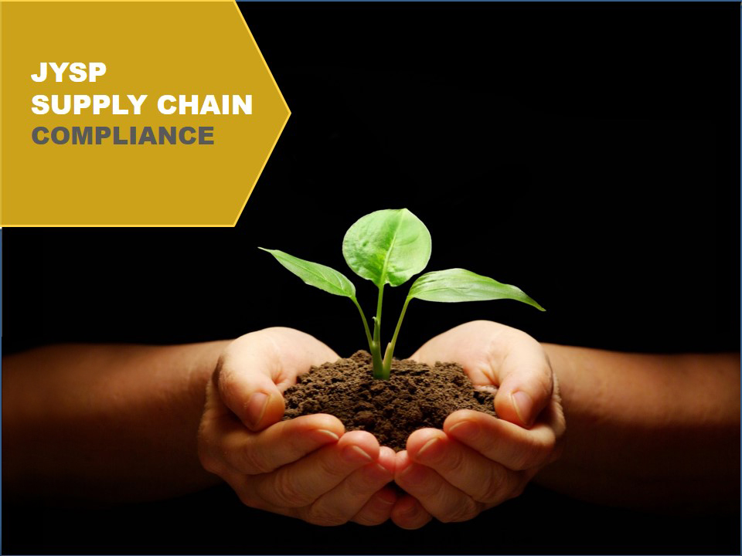
ORGANIC AND CRAFT
SUPPLY CHAIN
MARKET
RESEARCH

Slide 19

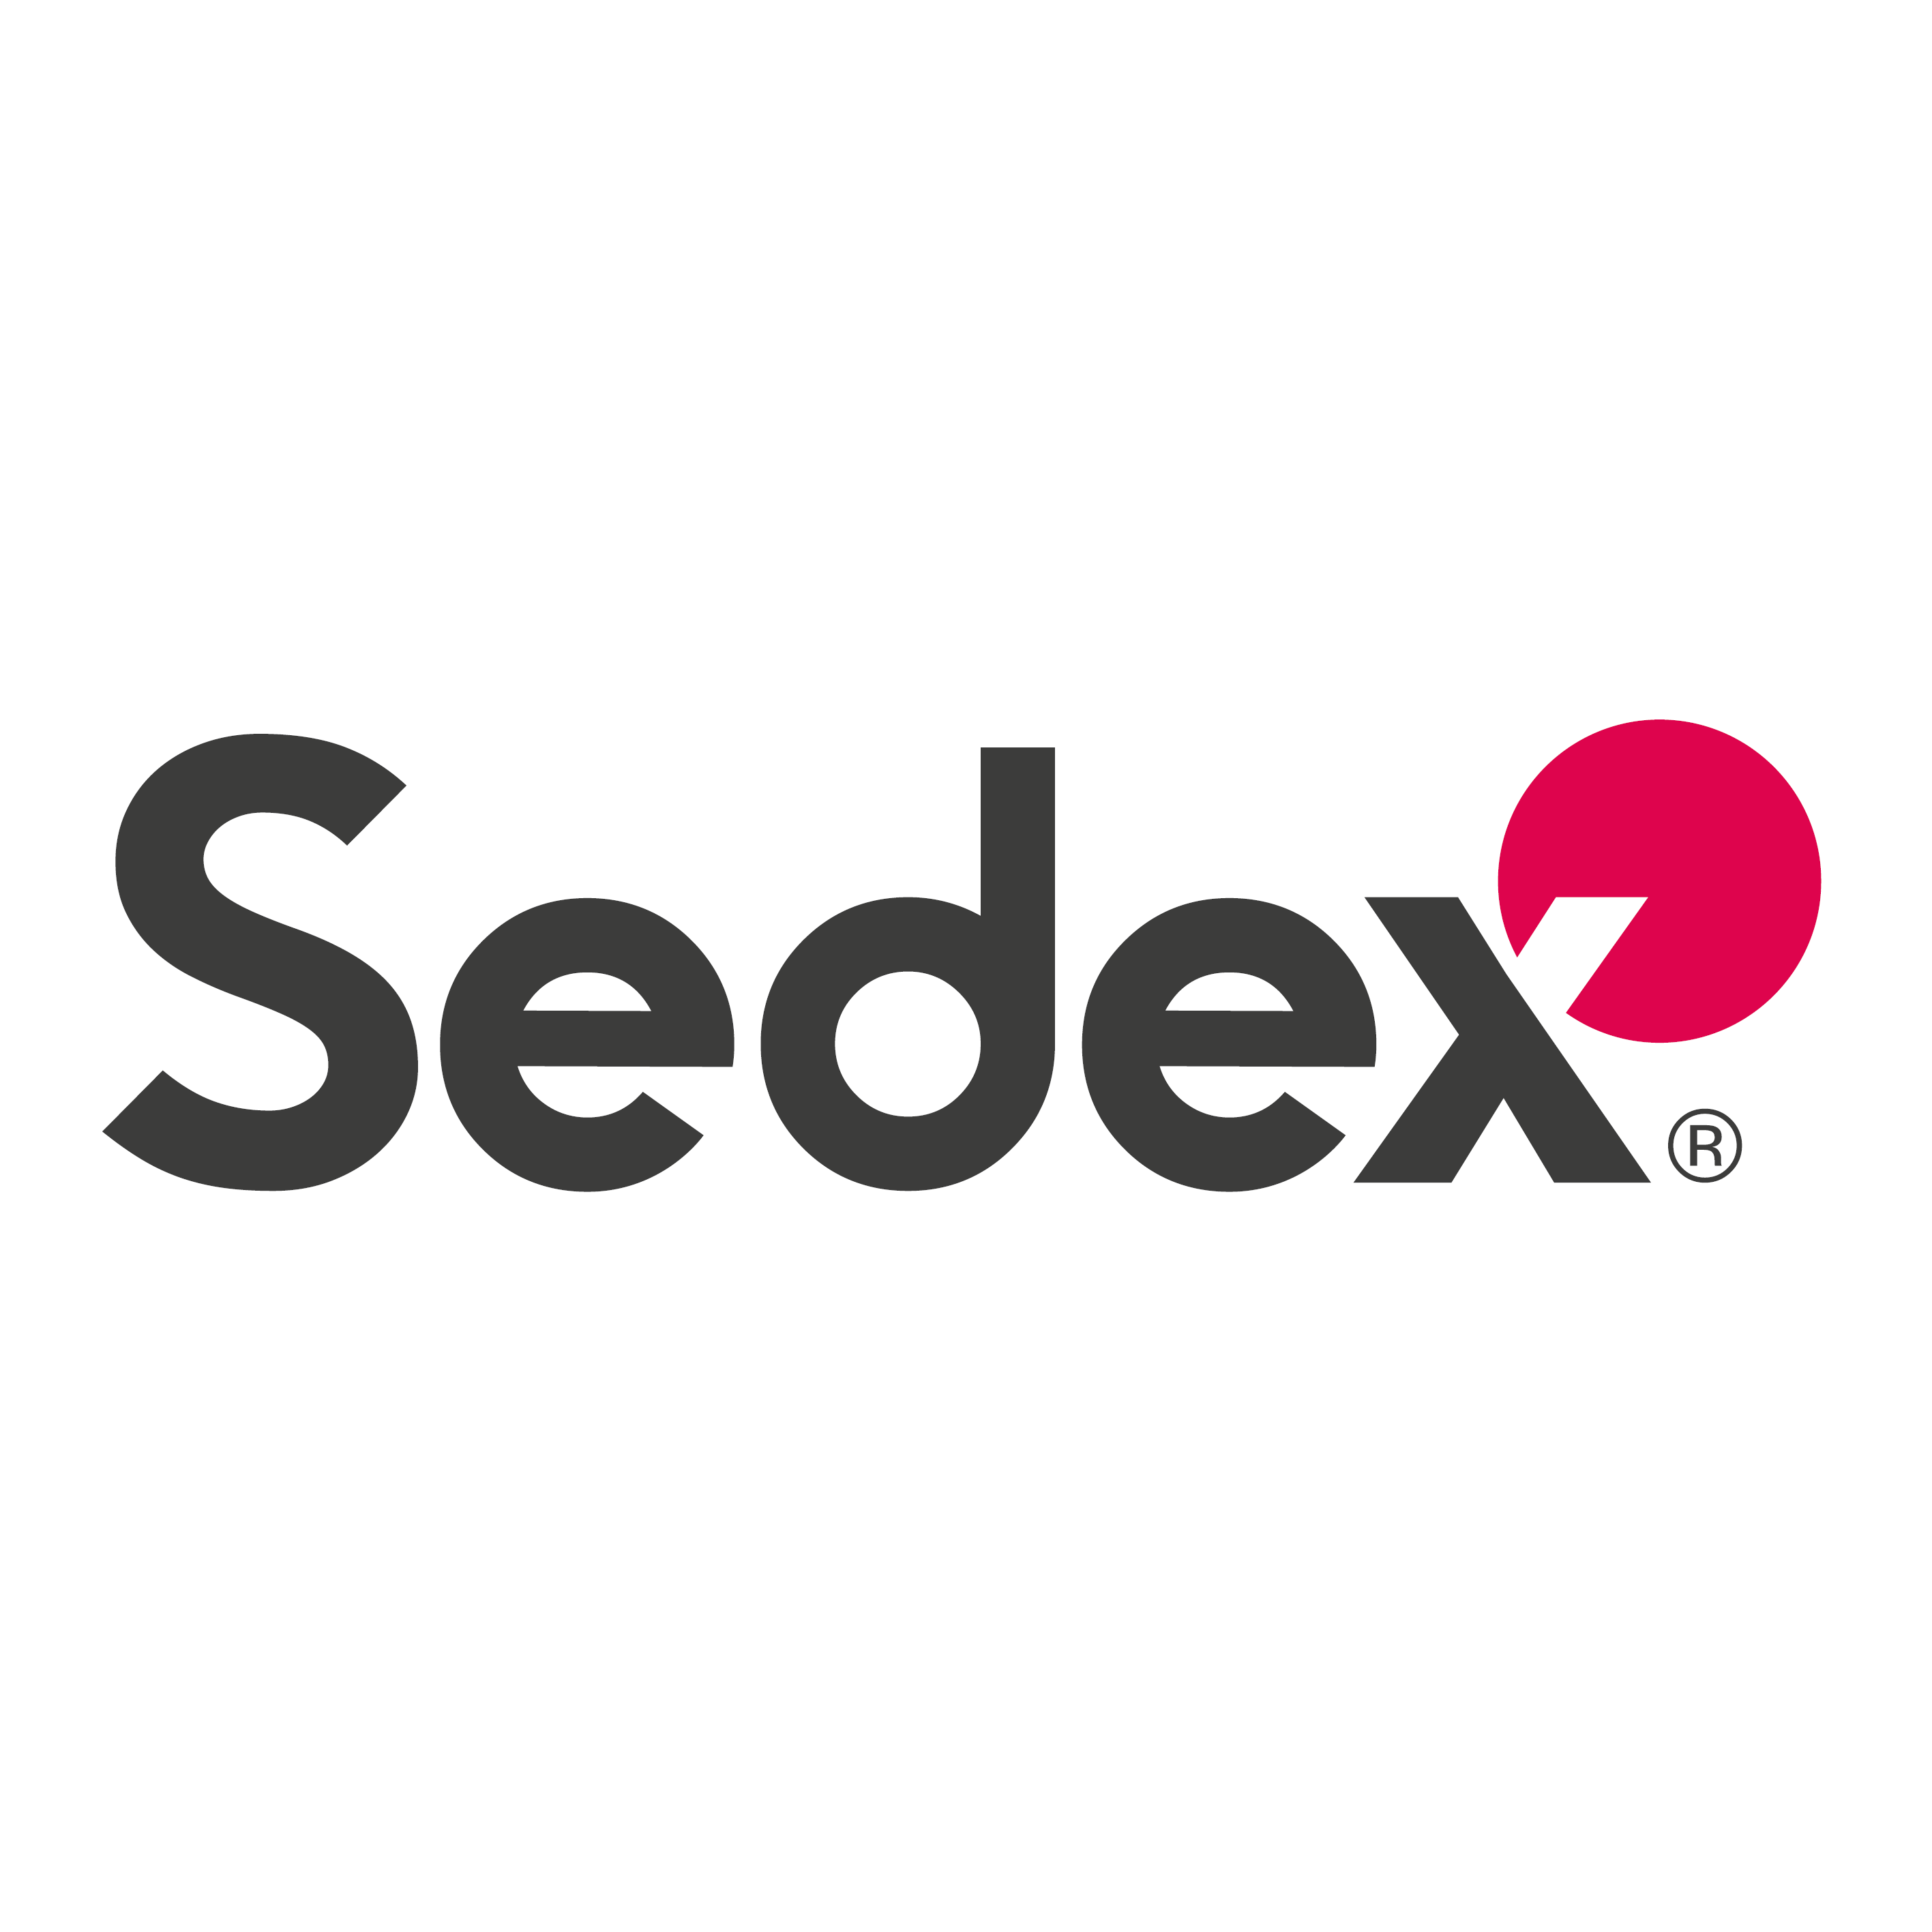





08
COMPLIANCE
At Organic and Craft, we faithfully ensure that Social or Technical Compliances are met! We offer prominent guidance to factories to become compliance ready and make the process happens for you!
ISO
SEDEX
SA 8000
GOTS/ORGANIC CERTIFIED
BSCI
CTPAT
OEKO-TEX
SOCIAL COMPLIANCE
TECHNICAL COMPLIANCE
EXTEND GUIDANCE TO FACTORIES TO BECOME COMPLIANCE READY

Slide 20
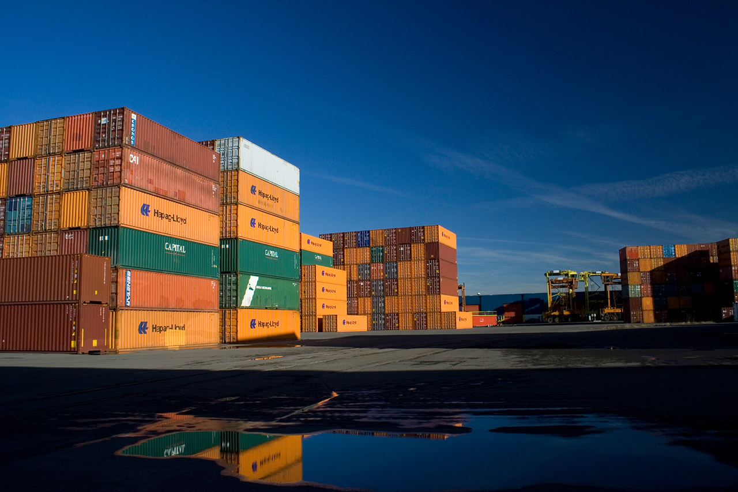
Make in India

Slide 21
Contact us :
Organic And Craft
A-9 Garden Enclave,Jalpura
Ecotech Sec-1, Uttar Pradesh
Greater Noida-201306 ( INDIA)
Phone: +91-9599774862
enquiry@organicandcraft.com
www.organicandcraft.com

